Slide 1
Introduction to SDMX

Slide 2
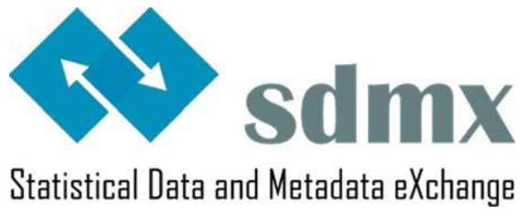
What is SDMX?
An international initiative to standardize and modernize the statistical data and metadata collection, processing, and exchange
Certified by the ISO (International Organization for Standardization)
Preferred standard for the exchange and sharing of data and metadata by the UN Statistical Commission

Slide 3
Key Use Cases of SDMX
Data Collection
Data collection refers to the process of gathering statistical source information by various means, such as surveys, censuses, polls, or administrative records.
Data Reporting
Data reporting refers to submitting statistical data to a central authority or repository. This could be a national statistics office, an international organization, or any other entity responsible for collecting and managing statistical information.
Data Dissemination
Data dissemination involves making statistical information available to users, including the general public, policymakers, researchers, and other stakeholders.
Disseminate Data through Application Programming Interface (API).

Slide 4
Goal of SDMX
The goal is to create common standards for exchange of statistical data and metadata to gain efficiency and avoid duplication of effort in our own work and possibly for the work of others in the field of statistical information.

Slide 5
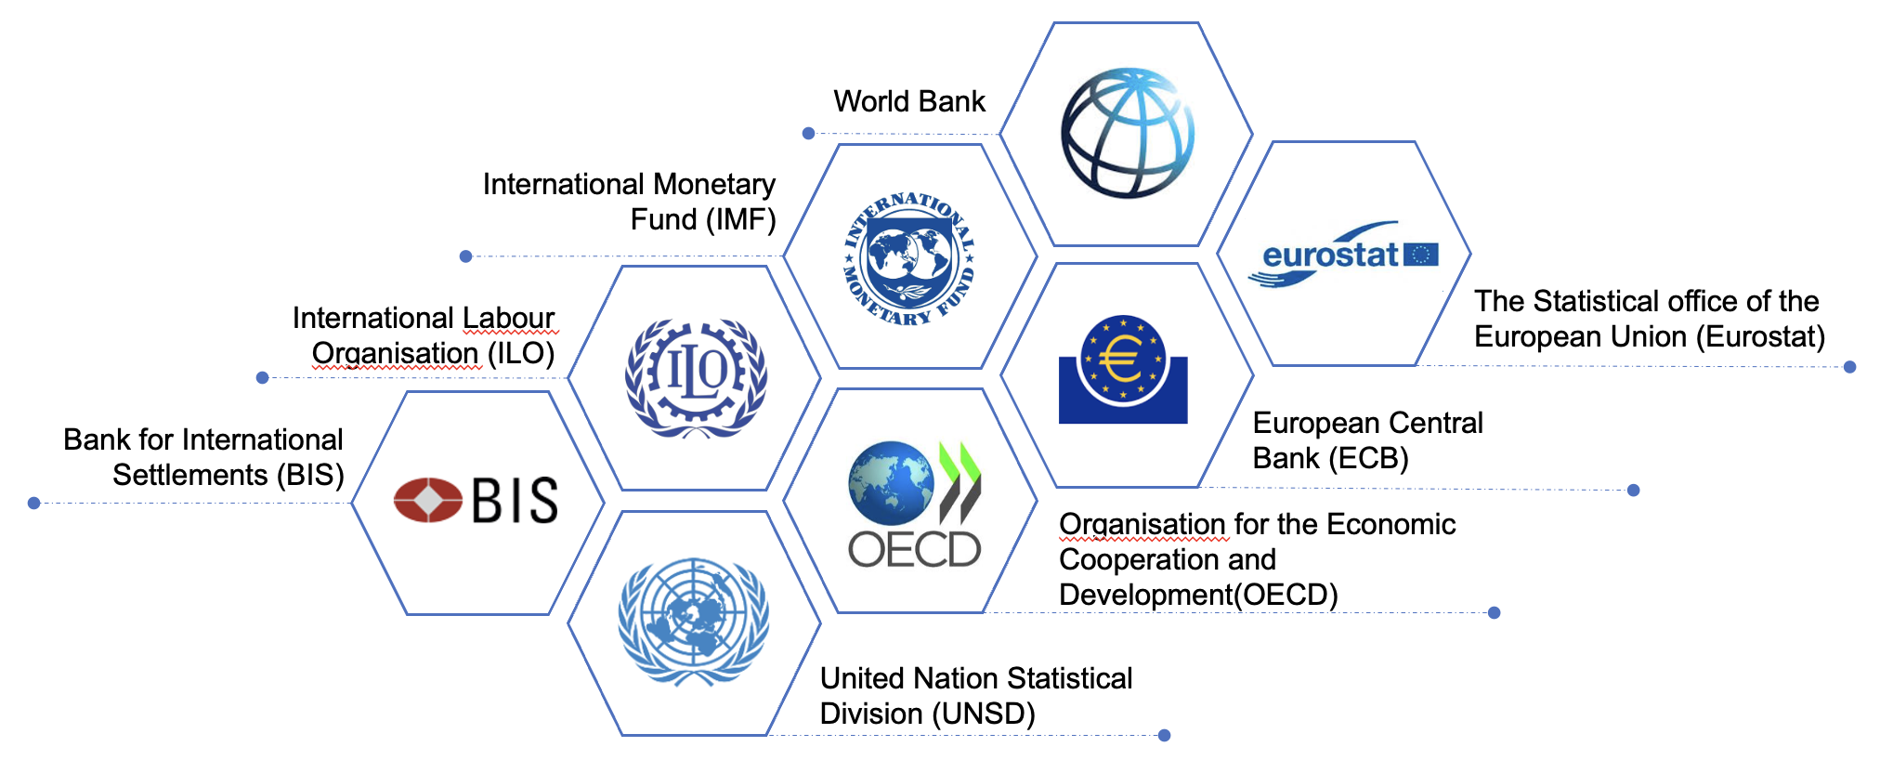








Benefits of SDMX
Stability through Strong Commitment and Governance
Enhanced Data Consistency and Comparability
Availability of Free and Open-Source Tools

Slide 6






Benefits of SDMX
Minimize Burden of Data Reporting
Easier Access to Data
Improved Data Quality and Timeliness
Support from a Global Community of Statistical Practitioners

Slide 7
The SDMX Components
SDMX Information Model
Content-Oriented Guidelines
SDMX Infrastructure
Core of SDMX
Formats
Structures
Functionalities
Harmonization and Governance of Concepts
Management
Concepts
Classifications
Methodologies
Modelling
Support for the SDMX Implementation
Design
Map
Package
Exchange
Disseminate

Slide 8
SDMX Information Model

Slide 9

202
ITEM | VALUE
Topic | Total Population
Location | Samoa
Year | 2020
Unit of Measure | Person
Magnitude | Thousand
TOTAL POPULATION (in thousand)
Country | 2017 | 2018 | 2019 | 2020 | 2021 | 2022 | 2023
Fiji | 885 | 886 | 889 | 891 | 894 | 900 | 897
Palau | 18 | 18 | 17 | 18 | 18 | 18 | 18
Papua New Guinea | 8746 | 9019 | 9300 | 9590 | 11782 | 12149 | 12527
Samoa | 197 | 199 | 200 | 202 | 204 | 207 | 209
Solomon Islands | 686 | 704 | 721 | 725 | 740 | 754 | 769
Tuvalu | 11 | 11 | 11 | 11 | 11 | 11 | 11
Vanuatu | 279 | 285 | 292 | 300 | 307 | 314 | 321
201,925
202
https://kidb.adb.org

Slide 10




SDMX Information Model
Forms the core of SDMX
Describes statistics in a standard way
Identifies objects and their relationships
Allows central management and standard access
“In other words, statistical data, metadata and the data exchange process are all modelled.”

Slide 11
Introduction to Data Modeling
What is Data Modeling?
Identifying things
Describing those things
How things relate to each other
Formally codify

Slide 12
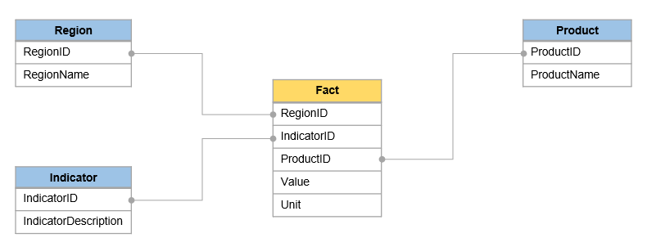
Developing a Data Model for Data Exchange
Data model is developed to provide descriptions for all relevant characteristics of the data to be exchanged
In some aspect, it is similar to developing a relational database
In SDMX, a data model is represented by a Data Structure Definition (DSD)
The “shape” of SDMX DSD is roughly similar to a database “star schema”

Slide 13
Data Structure Definition
Set of structural metadata associated to a data set, which includes information about how concepts are associated with the measures, dimensions, and attributes of a data cube, along with information about the representation of data and related descriptive metadata.

Slide 14
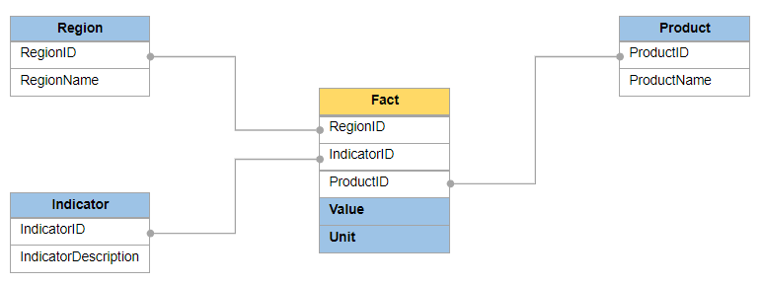
Concept
Unit of thought created by a unique combination of characteristics
Each concept describes something about the data
Concepts should express all relevant data characteristics

Slide 15
Identifying Concepts
Unit of Measure
Unit Multiplier
Indicator
Frequency
Reference Area
Time Period
Observation Value

Slide 16
SDMX Concept Scheme
Set of Concepts that are used in a Data Structure Definition or Metadata Structure Definition.
Concept scheme places concepts into a maintainable unit.
Concept Name
Indicator
Reference area
Time period
Frequency
Unit of measure
Unit multiplier
Observation value
Concept ID
INDICATOR
REF_AREA
TIME_PERIOD
FREQ
UNIT_MEASURE
UNIT_MULT
OBS_VALUE

Slide 17
Dimension
Which of the concepts are used to identify an observation?
Indicator
Reference area
Time period
When all 3 are known, we can unambiguously locate an observation in the table.
These are called dimensions.
A dimension is similar in meaning to a database table’s primary key field.
Statistical concept used in combination with other statistical concepts to identify a statistical
series or individual observations.

Slide 18
Attribute
Unit of Measure and Unit Multiplier represent additional information about the observation.
These concepts is not used to identify a series or observation.
Such concepts are called attributes.
Statistical concept providing qualitative information about a specific statistical object.
Similar to a database table’s non-primary key fields.

Slide 19
Primary Measure
Observation Value represents a concept that describes the actual values being transmitted.
In SDMX, such a concept is called Primary Measure.
Primary Measure is usually represented by concept with ID OBS_VALUE.

Slide 20
Special Dimensions
TIME dimension provides observation time. If a DSD describes time series data, it must have one TIME dimension.
FREQUENCY dimension describes interval between observations. If there is a TIME dimension, one other dimension must be marked as FREQUENCY dimension.

Slide 21
Attribute Attachment
In SDMX 2.1, attributes can be attached at observation, dimension(s), group, or dataset.
When an attribute is attached to all dimensions except time, it is effectively attached
to time series
For practical purposes attributes are often attached at observation or time series.
In addition, attributes can be designated as mandatory or conditional (optional). Mandatory attributes must be present at their attachment level for the dataset to be valid, while conditional attributes may be skipped.
Dimensions, by contrast, must always be provided.

Slide 22
Data model so far…
Concept
Indicator
Reference area
Time period
Frequency
Unit of measure
Unit multiplier
Observation value
Concept ID
INDICATOR
REF_AREA
TIME_PERIOD
FREQ
UNIT_MEASURE
UNIT_MULT
OBS_VALUE
Role
Dimension
Dimension
Dimension
Dimension
Attribute
Attribute
Pr. Measure
Attachment
Time series
Time series

Slide 23
Representation
DSD defines a range of valid values for each concept.
When data are transferred, each of its descriptor concepts must have valid values.
A concept can be
Coded
Un-coded with format
Un-coded free text

Slide 24
Code
“A language-independent set of letters, numbers or symbols that represent a concept whose meaning is described in a natural language.”
A sequence of characters that can be associated with descriptions in any number of languages.
Descriptions can be updated without disrupting mappings or other components of data exchange.

Slide 25
Code List
A predefined list from which some statistical coded concepts take their values.
A code list is a collection of codes maintained as a unit.
A code list enumerates all possible values for a concept or set of concepts
Sex code list
Country code list
Indicator code list

Slide 26
Code List
Code lists are primarily used to:
collect, disseminate, exchange and organise information
aggregate and disaggregate datasets in a meaningful way for complex analysis
present statistical information in a standard way
support policy and decision-making
standardise the measurement process

Slide 27
Code List
Properties of Code Lists:
Code list identifier (“CL_”)
Three mandatory elements:
id
version number
maintenance agency
Name
Description (optional)
It may also contain annotations, a URI, period of validity (“valid to” and “valid from”), a state if “final” or “non-final”.

Slide 28
Code List: Some Examples
CL_FREQ
Code | Name | Description
A | Annual | To be used for data collected or disseminated every year.
Q | Quarterly | To be used for data collected or disseminated every quarter.
M | Monthly | To be used for data collected or disseminated every month.
W | Weekly | To be used for data collected or disseminated every week.
D | Daily | To be used for data collected or disseminated every day.
CL_AREA (partial)
Code | Name
US | United States of America
JP | Japan
AU | Australia
CN | China
FR | France
ZA | South Africa
CL_UNIT_MULT
Code | Name
0 | Units
1 | Tens
2 | Hundreds
3 | Thousands
6 | Millions
9 | Billions

Slide 29
SDMX Concepts and Code lists
Code lists provide a representation for concepts, in terms of Codes.
Codes are language-independent and may include descriptions in multiple languages.
Code lists must be harmonized among all data providers that will be involved in exchange.

Slide 30
Cross-Domain Concepts
Describe concepts relevant to many statistical domains.
By cross-domain, the guidelines indicate that a statistical concept is used in more than one different statistical domain in a materially similar form.
SDMX Statistical Working Group (SWG) develops and publishes Cross-Domain Concepts

Slide 31
Cross-Domain Concepts
Efficient and automated
Some Benefits
of Using
Cross-Domain Concepts
Consistent metadata
Re-usability

Slide 32
Cross-Domain Concepts
Properties of Cross-Domain Concepts:
Unique identifier maintained by the Maintenance Agency
Mandatory name and description
If concept is “coded”, must have a link to a code lists
The Maintenance Agency is SDMX

Slide 33
Cross-Domain Concepts
“It is strongly advised to use the same names for cross-domain concepts when modeling new DSDs, being TIME_PERIOD and OBS_VALUE the most important“.
Id | Name | Description
AGE | Age | Length of time that an entity has lived or existed.
FREQ | Frequency of observation | Time interval at which observations occur over a given time period.
SEX | Sex | State of being male or female.
TIME_PERIOD | Time period | Timespan or point in time to which the observation actually refers.
UNIT_MULT | Unit multiplier | Exponent in base 10 specified so that multiplying the observation numeric values by 10^UNIT_MULT gives a value expressed in the unit of measure.
OBS_VALUE | Observation value | Value of a particular variable.

Slide 34
Un-coded Concepts
Can be free-text: Any valid text can be used as a value for the concept.
Footnote
Can have their format specified
Postal code: 5 digits
Last update: date/time

Slide 35
Representation of concepts in SDMX
Dimensions must be either coded or have their format specified.
Free text is not allowed.
Attributes can be coded or un-coded; format may optionally be specified.

Slide 36
Data model so far…
Concept | Concept ID | Role | Attachment
Indicator | INDICATOR | Dimension
Reference area | REF_AREA | Dimension
Time period | TIME_PERIOD | Dimension
Frequency | FREQ | Dimension
Unit of measure | UNIT_MEASURE | Attribute | Time series
Unit multiplier | UNIT_MULT | Attribute | Time series
Observation value | OBS_VALUE | Pr. Measure
Representation
Coded
Coded
Date/time (YYYY)
Coded
Coded
Coded
Floating point number

Slide 37
Generic cross-domain codes
Recommended Code Value | Recommended Code Description
_L | Local extension (can be used as a prefix)
_N | Non response
_O | Other
_S | Subtotal
_T | Total
_U | No data/unknown
_X | Not allocated/unspecified
_Z | Not applicable
These codes are recommended to be used in all code lists.

Slide 38
Data model so far: Code Lists
CL_INDICATOR
Code | Name
GDP_CUR | Gross Domestic Product, at Current Prices
CL_UNIT_MULT
CL_AREA (partial)
Code | Name
0 | Units
1 | Tens
2 | Hundreds
3 | Thousands
6 | Millions
9 | Billions
Code | Name
CK | Cook Islands
FJ | Fiji
NR | Nauru
PG | Papua New Guinea
WS | Samoa
TV | Tuvalu

Slide 39
Data Structure Definition: summary
Concept Scheme
Reference
DSD
Reference
Code lists
Concept | Concept ID | Role | Attachment | Representation | Code list ID
Indicator | INDICATOR | Dimension |  | Coded | CL_INDICATOR
Reference area | REF_AREA | Dimension |  | Coded | CL_AREA
Time period | TIME_PERIOD | Dimension |  | YYYY
Frequency | FREQ | Dimension |  | Coded | CL_FREQ
Unit of measure | UNIT_MEASURE | Attribute | Time series | Coded | CL_UNIT_MEASURE
Unit multiplier | UNIT_MULT | Attribute | Time series | Coded | CL_UNIT_MULT
Observation value | OBS_VALUE | Pr. Measure |  | Floating point number

Slide 40
Dataset
Organised collection of data defined by a Data Structure Definition (DSD)*
A dataset is structured in accordance with one DSD
Serves as a container for time-series or non-time series data in SDMX data messages.

Slide 41
Time Series
A set of observations of a particular variable, taken at different points in time.
Observations that belong to the same time series, differ in their time dimension.
All other dimension values are identical.
Observation-level attributes may differ across observations of the same time series.

Slide 42
Time Series: Demonstration

Slide 43
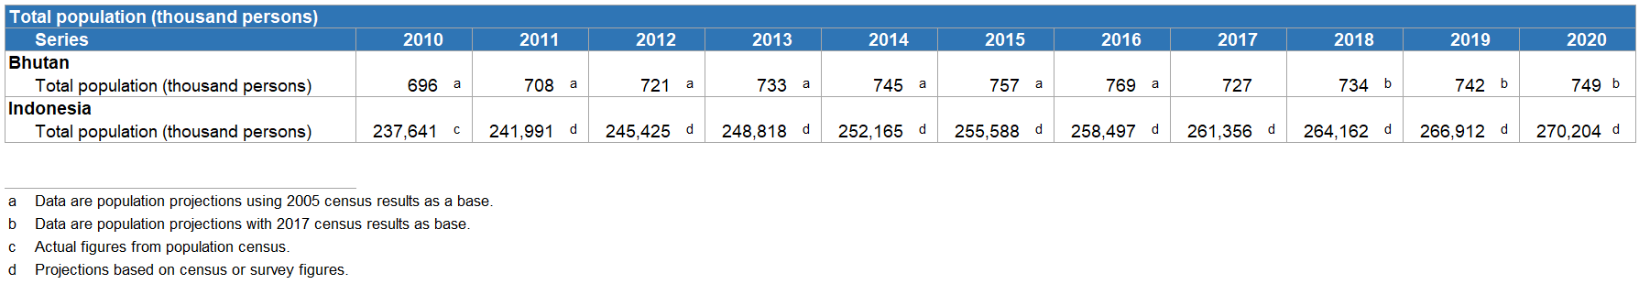
Time Series: Demonstration
Note: Observation-level attributes may differ across observations of the same time series.

Slide 44
Non-Time Series Data
A non-time dimension(s) is chosen along which a set of observations is constructed.
E.g., for a survey or census the time is usually fixed, and another dimension may be chosen to be reported at the observation level
Used less frequently than time series representation

Slide 45
Keys in SDMX
Series key uniquely identifies a series
In the case of time series, consists of all dimensions except time
Group key uniquely identifies a group of time series
Consists of a subset of the series key

Slide 46

Structural and Reference Metadata
Structural Metadata: Identifiers and Descriptors
Data Structure Definition
Concept Scheme
Code
Reference Metadata: Describes contents and quality of data
Indicator definition
Comments and limitations
What we have covered so far

Slide 47
Reference Metadata in SDMX
Describes the contents and quality of the statistical data.
Preferably, reference metadata should include the following:
Conceptual metadata
Methodological metadata
Quality metadata
Can be stored or exchanged separately from the object it describes, but be linked to it
Reported according to a defined structure

Slide 48
Metadata Structure Definition (MSD)
MSD Defines:
The object type to which reference metadata can be associated
E.g., DSD, Dataflow
The components comprising the object identifier of the target object
E.g., the draft SDG MSD allows metadata to be attached as a partial key
Concepts used to express metadata (“metadata attributes”)
E.g., Indicator Definition, Quality Management

Slide 49
Dataflow and Metadataflow
Dataflow defines a “view” on a Data Structure Definition (DSD)
Can be constrained to a subset of codes in any dimension
Can be categorized, i.e., can have categories attached
In its simplest form defines any data valid according to a DSD
Similarly, Metadataflow defines a “view” on a Metadata Structure Definition

Slide 50
Content Constraints
Constraints can be used to define which combinations of codes are allowed
E.g., When SERIES= “Proportion of Women in Commune Councils”, SEX must be “Female”
Constraints can define more granular validation rules than a simple validation of codes
Are often attached to the Dataflow but can also be attached to DSD, Provision Agreement, etc.

Slide 51
Category, Category Scheme, and Categorisation
Category is a way of classifying data for reporting or dissemination
Subject matter-domains are commonly implemented as Categories, such as “Demographic Statistics”, “Economic Statistics”
Category Scheme groups Categories into a maintainable unit.
Categorisation links a Category to the object to which it applies.

Slide 52
SDMX Messages
An SDMX message can be sent in several formats including:
XML – eXtensible Markup Language
JSON – JavaScript Object Notation
CSV – Comma-Separated Values
There are several types of SDMX messages, each serving a particular purpose
Structure message is used to transmit structural information such as DSD, MSD, Concept Scheme, etc.
GenericData, StructureSpecificData, and other messages are used to send data.
SDMX messages in the XML format are referred to as SDMX-ML messages.

Slide 53
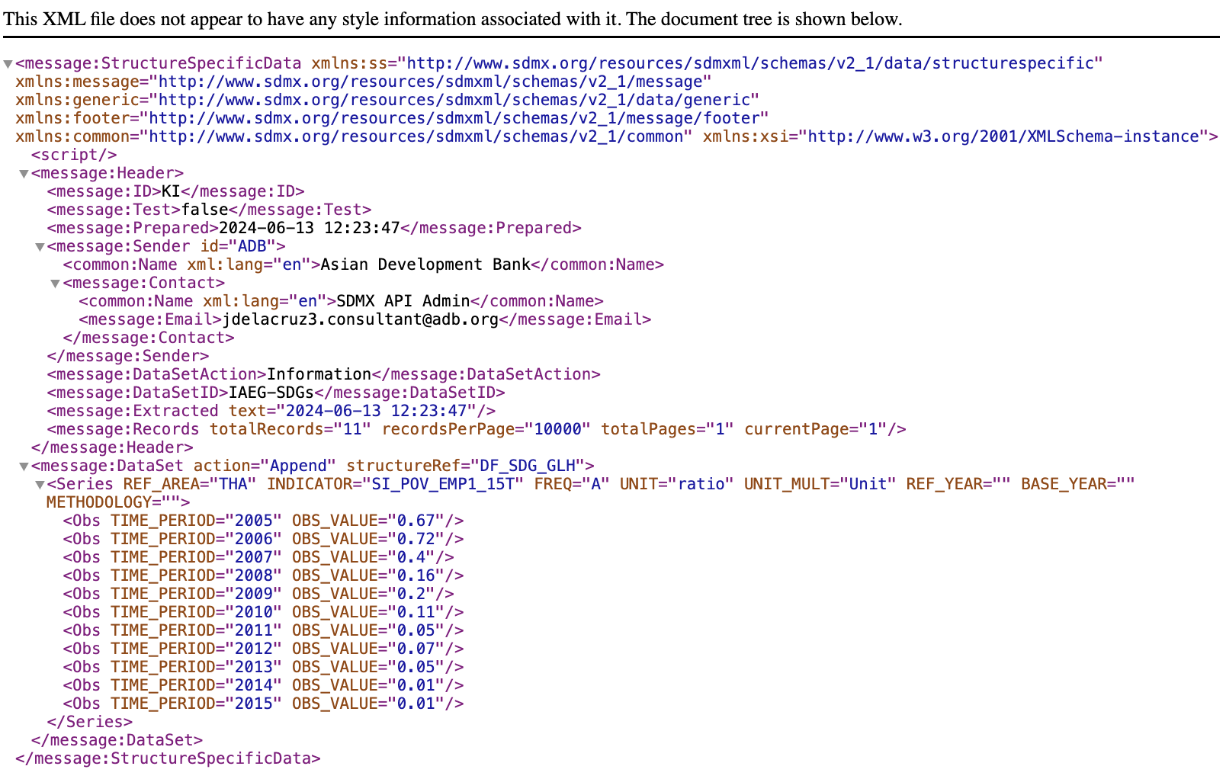
SDMX-ML Format

Slide 54
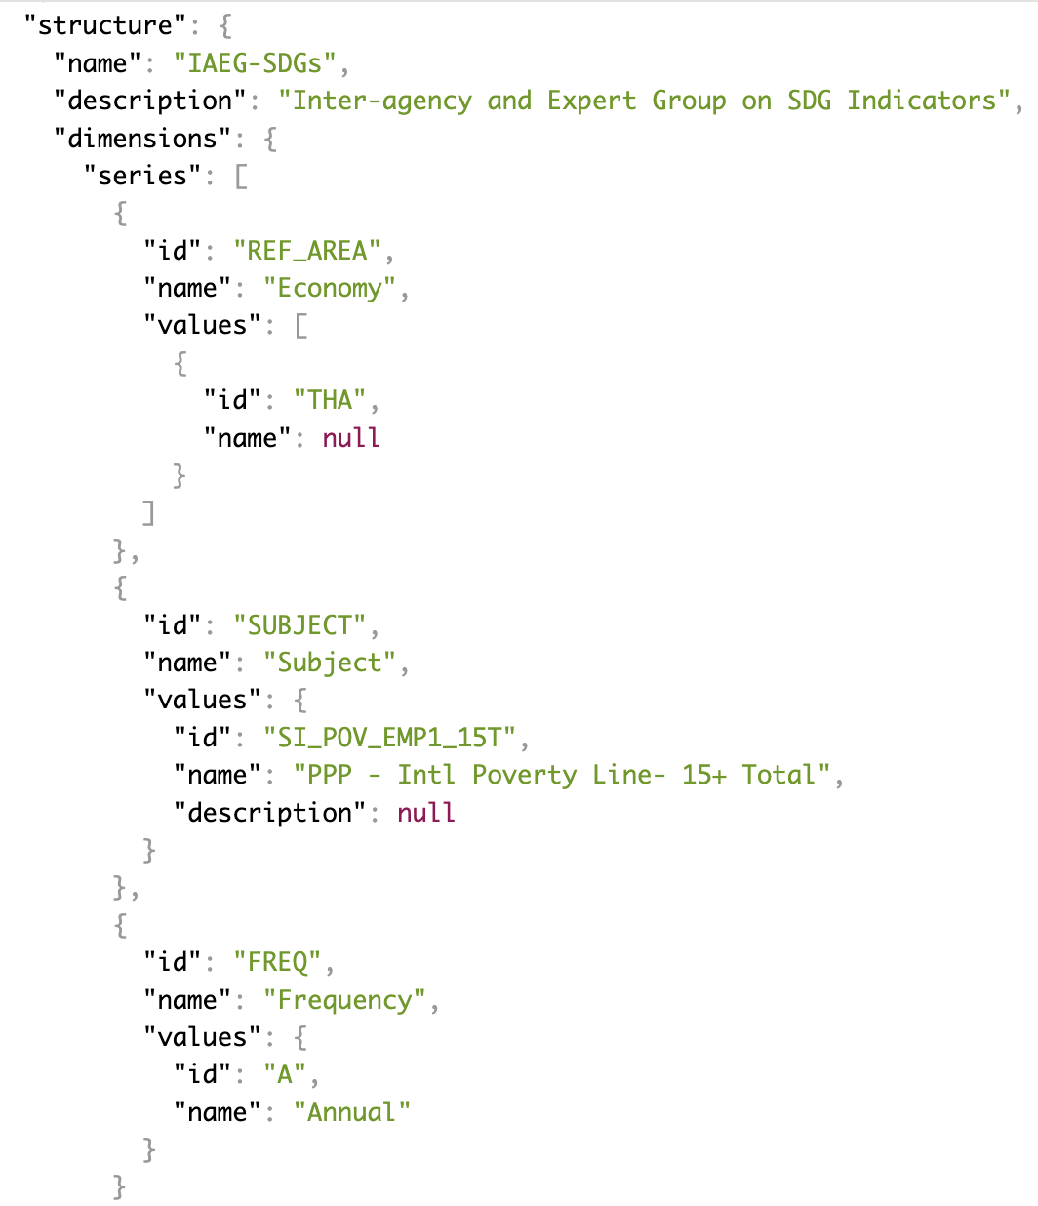
SDMX JSON Format

Slide 55
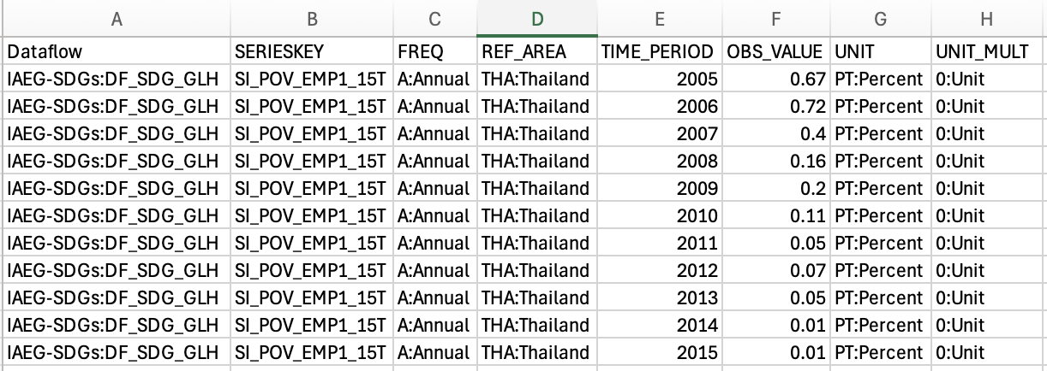
SDMX CSV Format

Slide 56
SDMX Artefacts
While there are many types of artefacts, in most situations “SDMX Artefact” refers to an identifiable, maintainable and versionable component of structural metadata.
Concept Scheme
DSD
Code List
Note that an individual Code is usually not referred to as an artefact, since it can only exist and be transmitted as part of a Code List.

Slide 57
SDMX Artefact Identification and Versioning
Identification of SDMX Artefact consists of 3 fields:
ID
Maintenance Agency
Version
Type | Name | ID | Maintenance Agency | Version
DSD | SDG DSD | SDG | IAEG-SDGs | 1.19
DSD | SDG DSD | SDG | IAEG-SDGs | 1.10
Concept Scheme | International Merchandise Trade Statistics | CS_IMTS | UNSD | 1.0
Code List | Reference area code list | CL_AREA | SDMX | 2.0

Slide 58
Thank You!

